Slide 1


THE ROLE OF CONVECTION IN COMMON ENVELOPE INTERACTIONS FOR MASSIVE STARS
Em Flynn
Mentors: Emily Wilson & Dr. Jason Nordhaus

Slide 2
Introduction
Common envelopes
Binary systems
Secondary star enters primary
Convection: energy transfer from molecule movement
Ejection efficiency
Orbital energy: energy released as the secondary travels through the primary
Percentage of orbital energy available to unbind the common envelope
Set constant based on observations of common envelope systems
Massive stars: at least 8 times the mass of the Sun
Source: https://www.sternwarte.uni-erlangen.de/~irrgang/animations/runaways/index.html
Notes:
Script here

Slide 3
Methods
Modules for Experiments in Stellar Astrophysics (MESA)
Interior can be found using complicated physics
Found convection zones
Area of common envelope where energy is transported to the surface through molecule movement
Used the location and size of the convection zones to estimate the ejection efficiency
Python, Jupyter Notebook for numerical analysis and plots
Notes:
Script here

Slide 4
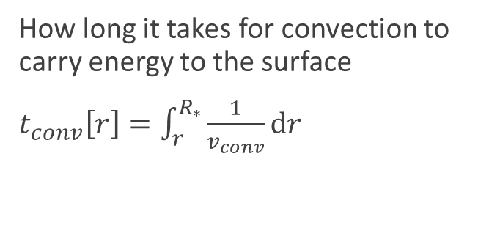
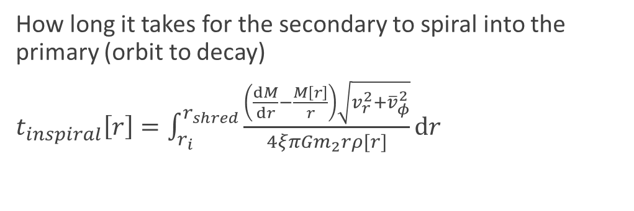
Time-scale
Convective time-scale
Inspiral time-scale
How long it takes for convection to carry energy to the surface
$t_{conv}\left[r\right]=\int_{r}^{R_{∗}}{\frac{1}{v_{conv}}dr}$
How long it takes for the secondary to spiral into the primary (orbit to decay)
$t_{inspiral}\left[r\right]=\int_{r_{i}}^{r_{shred}}{\frac{\left(\frac{dM}{dr}−\frac{M\left[r\right]}{r}\right)\sqrt{v_{r}^{2}+{\overline{v}}_{φ}^{2}}}{4ξπGm_{2}rρ[r]}dr}$
Notes:
Script here

Slide 5
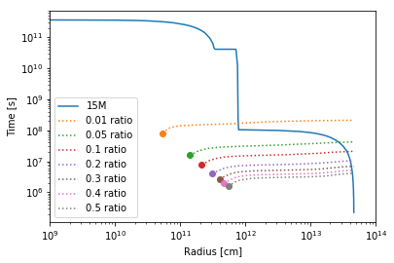
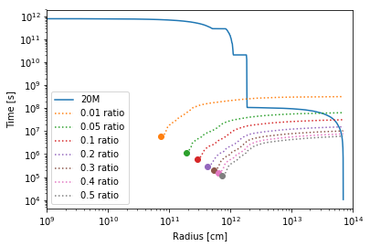
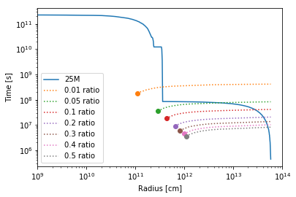
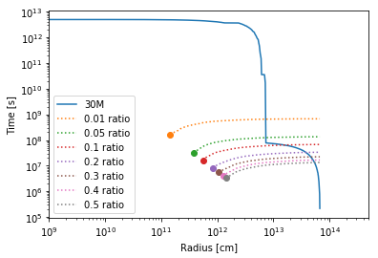
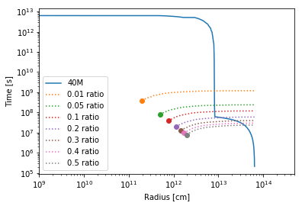
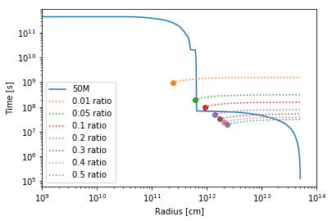
Notes:
This is a plot comparing the convective and inspiral time scales
The convective time-scale is the solid blue line, the inspiral time-scales are the dotted lines, and the dot where the inspiral time-scale ends is the shredding radius, so beyond that point the secondary doesn’t exist
On the x-axis is the radius, so how far you are into the star; on the y-axis is the time in seconds
If the convective time-scale is greater than the inspiral time-scale, convection cannot move anything, because the orbit of the secondary will have decayed before energy can be transported to the surface
If the inspiral time-scale is greater than the convective time-scale, convection is able to move some energy to the surface, though the exact amount depends on other factors

Slide 6
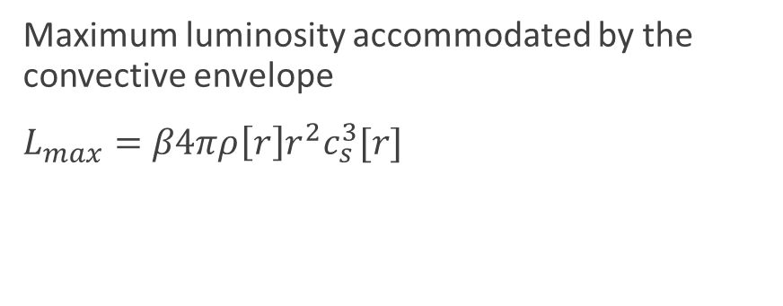
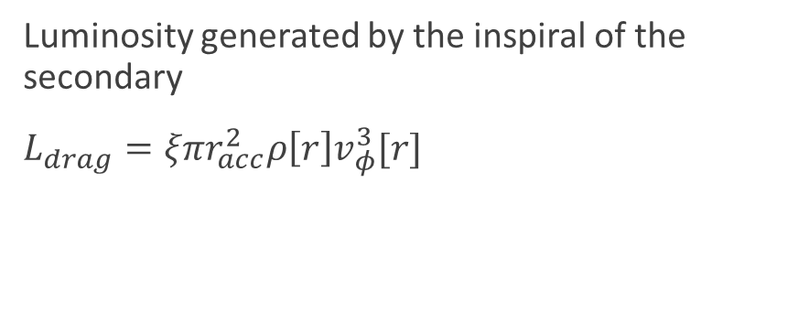
Luminosity
Maximum luminosity
Drag luminosity
Maximum luminosity accommodated by the convective envelope
$L_{max}=β4πρ\left[r\right]r^{2}c_{s}^{3}[r]$
Luminosity generated by the inspiral of the secondary
$L_{drag}=ξπr_{acc}^{2}ρ\left[r\right]v_{φ}^{3}[r]$
Notes:
Script here

Slide 7
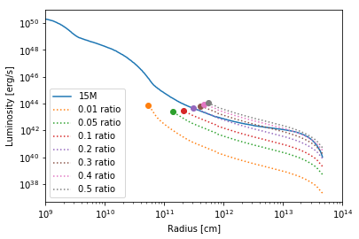
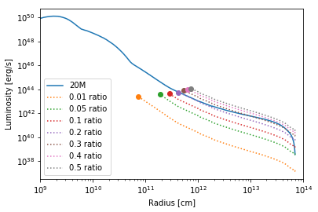
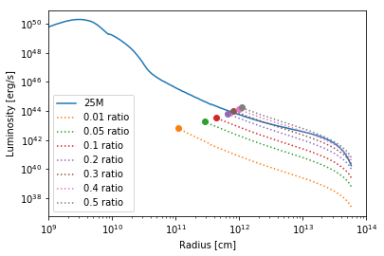
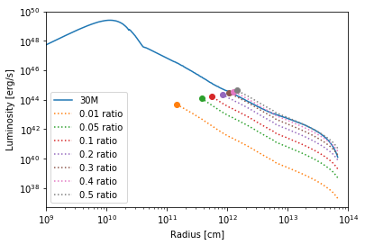
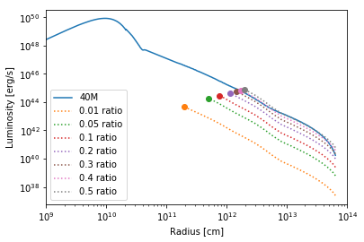

Notes:
This is a plot comparing the drag and maximum luminosities
On the x-axis is the radius; on the y-axis is the luminosity in ergs per second
If the maximum luminosity is greater than the drag luminosity, convection is able to remove all energy from the drag luminosity
If the drag luminosity is greater than the maximum luminosity, convection is able to remove some energy up to the maximum

Slide 8
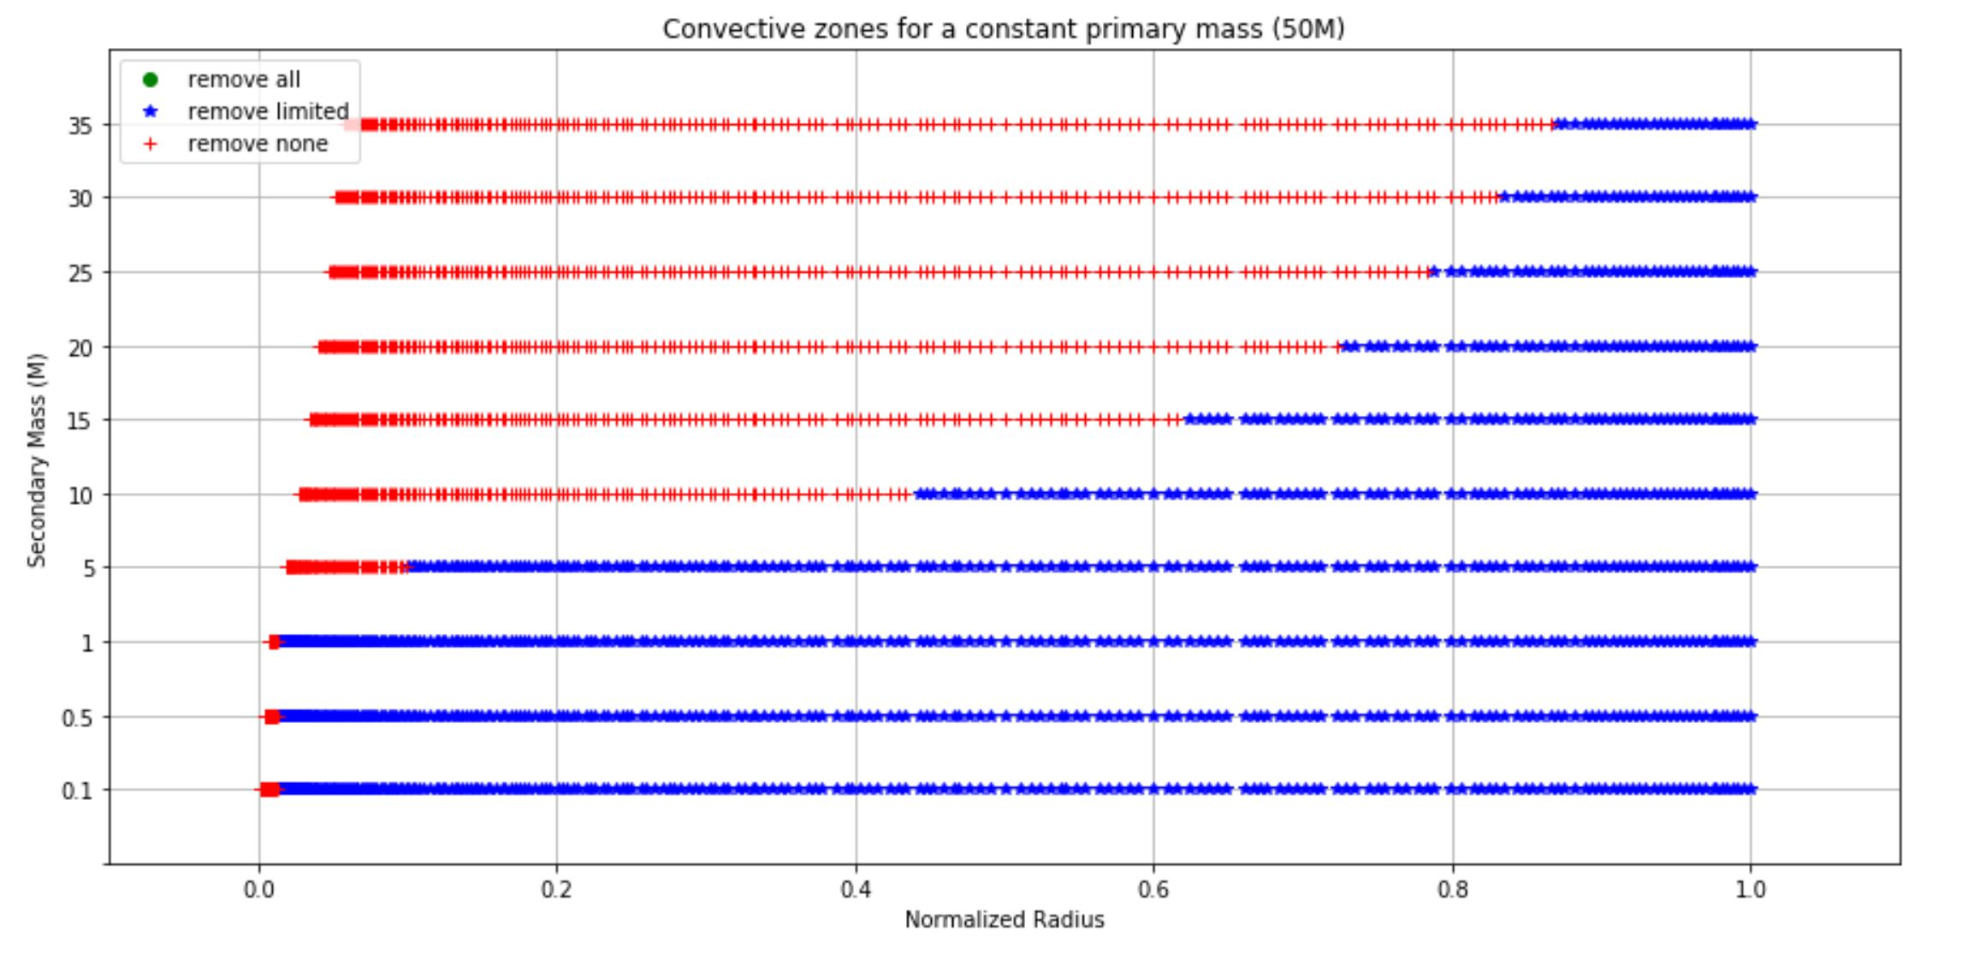

Remove limited energy: $t_{conv}<t_{inspiral}$& $L_{max}<L_{drag}$
Remove all energy: $t_{conv}<t_{inspiral}$ & $L_{max}>L_{drag}$
Remove no energy: $t_{conv}>t_{inspiral}$
As the mass of the secondary increases, it’s harder for energy to be removed
Notes:
Script here

Slide 9
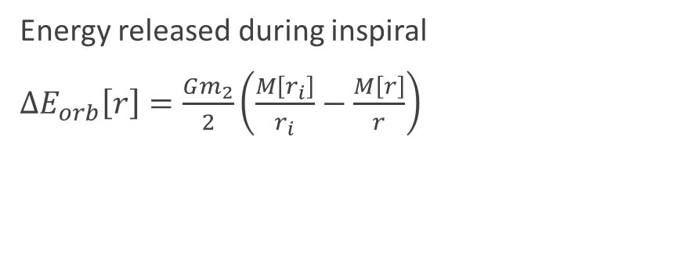
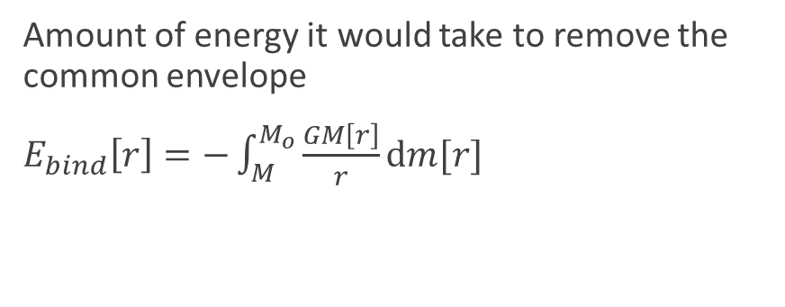
Energy
Binding energy
Change in orbital energy
Amount of energy it would take to remove the common envelope
$E_{bind}\left[r\right]=−\int_{M}^{M_{o}}{\frac{GM\left[r\right]}{r}dm[r]}$
Energy released during inspiral
$ΔE_{orb}\left[r\right]=\frac{Gm_{2}}{2}\left(\frac{M\left[r_{i}\right]}{r_{i}}−\frac{M\left[r\right]}{r}\right)$

Slide 10
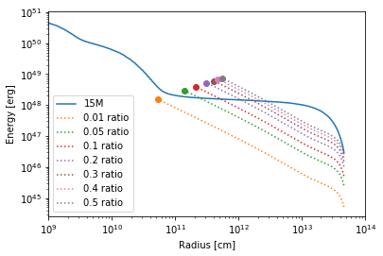
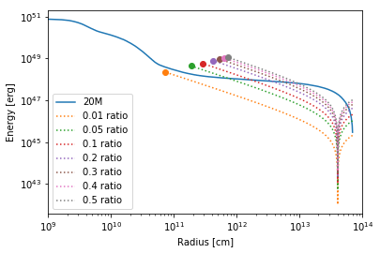
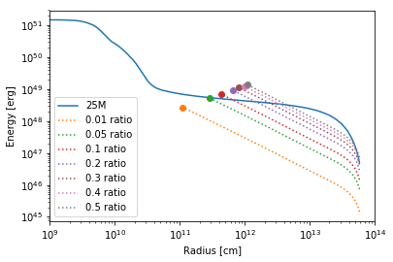
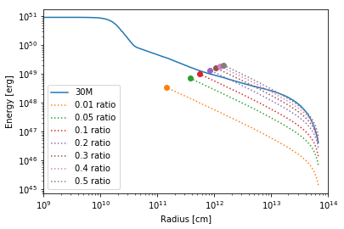
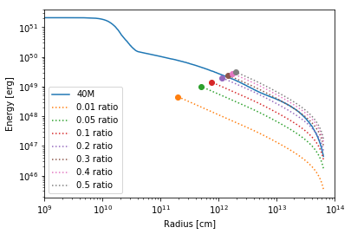
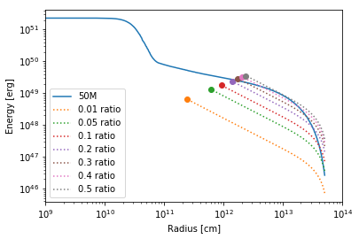
Notes:
This is a plot comparing the binding and change in orbital energy
On the x-axis is the radius; on the y-axis is energy in ergs
If the binding energy is greater than the change in orbital energy at the shredding radius, the secondary will shred during inspiral before enough energy is transferred to unbind the envelope of the primary
If the change in orbital energy is greater than the binding energy at the shredding radius, enough energy is transferred to unbind the envelope

Slide 11
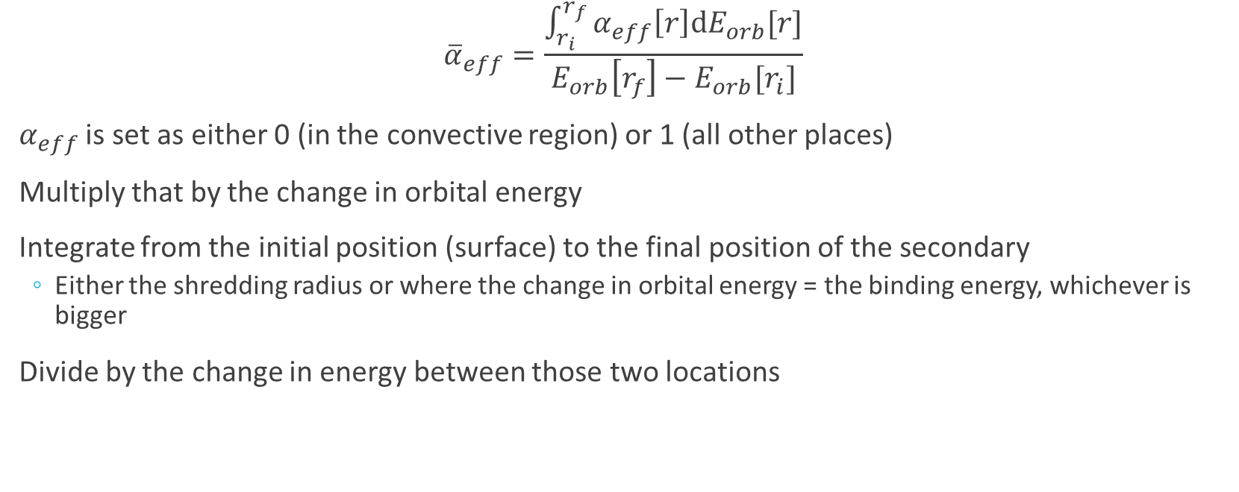
Ejection Efficiency
$${\overline{α}}_{eff}=\frac{\int_{r_{i}}^{r_{f}}{α_{eff}\left[r\right]dE_{orb}[r]}}{E_{orb}\left[r_{f}\right]−E_{orb}[r_{i}]}$$
$α_{eff}$ is set as either 0 (in the convective region) or 1 (all other places)
Multiply that by the change in orbital energy
Integrate from the initial position (surface) to the final position of the secondary
Either the shredding radius or where the change in orbital energy = the binding energy, whichever is bigger
Divide by the change in energy between those two locations

Slide 12
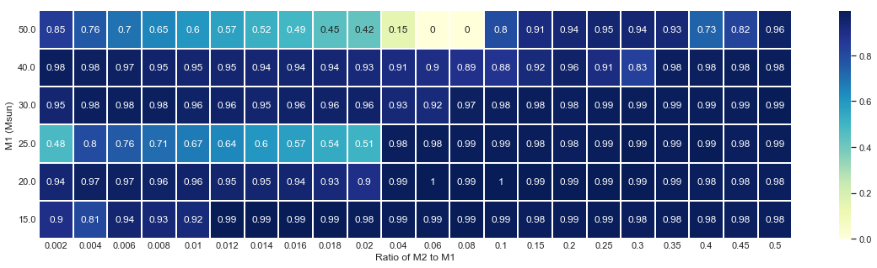

Slide 13
Notes:
Notice that on the last slide, the ejection efficiencies for 50M and 25M were a little weird – wanted to touch on why that is
For both of these, for lower masses, the secondary reaches the shredding radius very quickly after it enters the convective zone, so efficiency is low

Slide 14
Future Work
Expand to 60Msun – 100Msun stars
Applications: gravitational waves
Massive stars become black holes, neutron stars
Black holes/neutron stars close together cause gravitational waves
Binary systems cause black holes/neutron stars to be close
Lower efficiency means closer

Slide 15
References & Acknowledgements
Irrgang, A. (n.d.). Animations: Runaway Stars [GIF Image]. Retrieved July 29, 2019, from https://www.sternwarte.uni-erlangen.de/~irrgang/animations/runaways/index.html.
Wilson, E. & Nordhaus, J. (2019). The role of convection in determining the ejection efficiency of common envelope interactions. Monthly Notices of the Royal Astronomical Society, 485(4), 4492-4501. https://doi.org/10.1093/mnras/stz601
Thanks to Dr. Bonnie Jacob and all of the mentors for the NTID REU.
This material is based upon work supported by the National Science Foundation under Grant No.1659299, the National Aeronautics and Space Administration under Grant Nos. HST AR-15044 and HST AR-14563, and the National Technical Institute for the Deaf under Grant No. SPDI-15992.

